Slide 1

By Priyanka Nadar
Business Analyst Career Program - Capstone Project

Slide 2

Agenda
Data Exploration
Statistical Analysis using Excel
Graphical Analysis using Excel
Insert the given data into the SQL server
Import the Data from the SQL Database into PowerBI
Interactive Dashboard by using visualization tools
Conclusion and Inferences
Endnotes

Slide 3
Data Exploration
First part of data exploration comprises of studying the data and understanding what it is trying to convey
This is a sales data provided by the finance department for various products, classified on the basis of segments which sells these for countries from Europe and North America
The first step is data cleaning i.e. removing extra data/outliers to avoid redundancy and to derive proper results
We have an excel data comprising of 700 entries providing ample amount of information which will help us to gather insights as we proceed further

Slide 4

Data Cleaning
The amount in various columns are specified in dollars ($), changed the datatype to ‘General’ to ensure consistency
Two columns ‘Sales’ and ‘Gross Sales’ have same values, hence removed the latter
Added a new column ‘Discount %’, calculated the same using the formula: Discount Provided / Sales * 100
There’s a column named ‘Date’, then ‘Month Number’, ‘Month Name’ and ‘Year’ are extra columns. Removed the extra columns. Changed the ‘Date’ column type to ‘Custom – dd/mm/YYYY’ to avoid inconsistency with the timelines in further analysis

Slide 5
Data Cleaning
Before and After result after cleaning looks like the sample data snippet below
Save the file as CSV

Slide 6
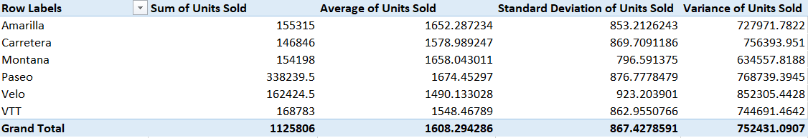
Statistical Analysis using Excel
Statistical analysis has been done on each products and the no. of units sold
On checking data in the below image, deviation from mean value is greater for the product ‘Velo’

Slide 7
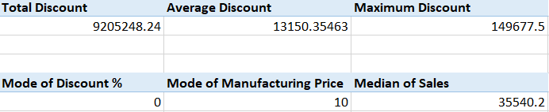
Statistical Analysis using Excel
Total, average, maximum and median values calculated for various parameters
More data can be found in worksheet named ‘KPIs’ from the cleaned dataset
From the mode calculation, it is understood that for most products, the segments in various countries don’t offer any sort of discount
Also, from the manufacturing price’s mode, we can infer that we have most entries for the product ‘Paseo’

Slide 8
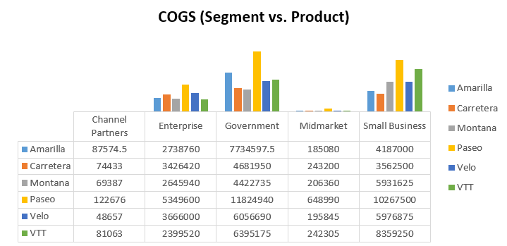
Graphical Analysis using Excel
Graphical analysis and appropriate visuals helps to understand the numbers in a prompt manner
Referring the image below, we can infer that the COGS(Cost of Goods Sold) for the product ‘Paseo’ in ‘Government’ segment is the highest

Slide 9
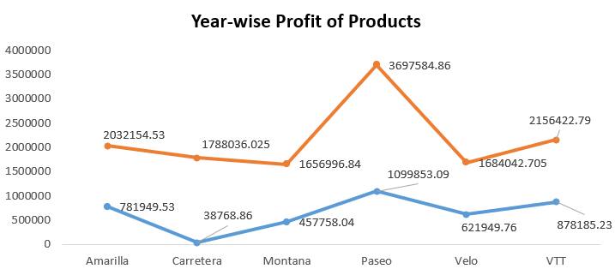
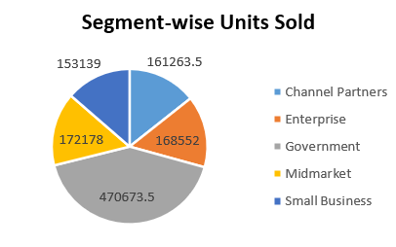
Graphical Analysis using Excel
Below mentioned two visuals suggest that the profit incurred by sales of the product ‘Paseo’ is highest for both the years (2013 & 2014), and the most sales is done by the ‘Government’ segment, followed by ‘Midmarket’

Slide 10
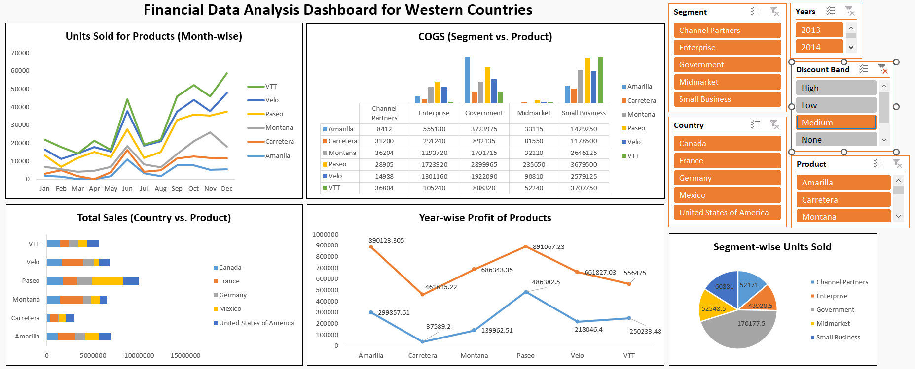
Overall Dashboard

Slide 11
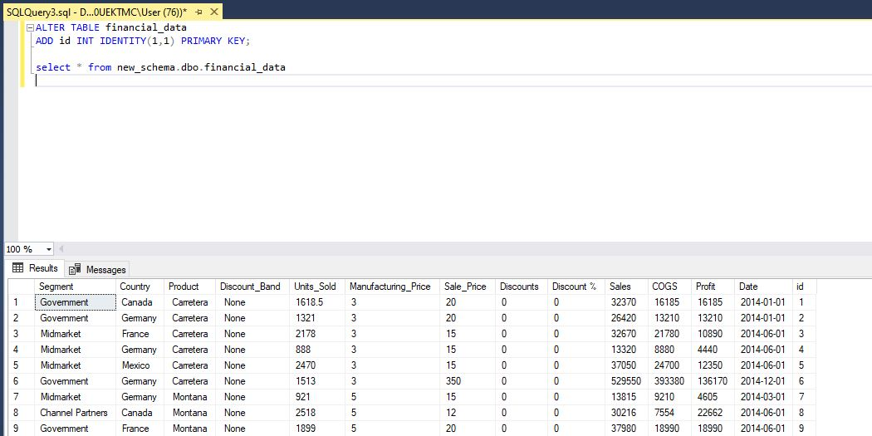
Insert the given data into the SQL server
Added a new column id (Primary Key), please find the attached screenshot

Slide 12
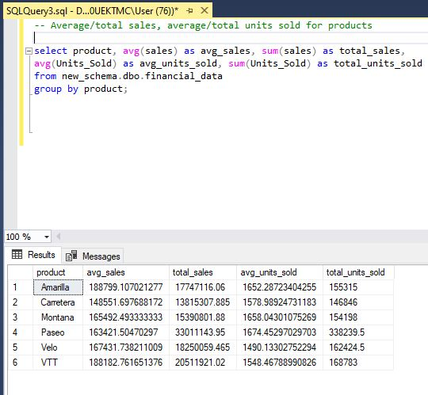
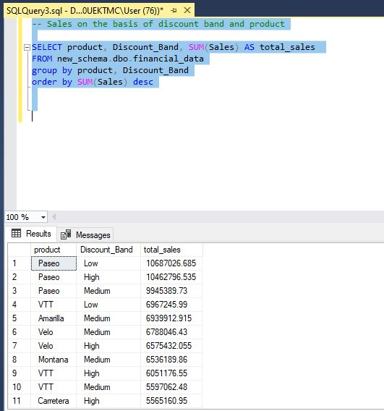
Insert the given data into the SQL server
Please find the attached screenshots

Slide 13
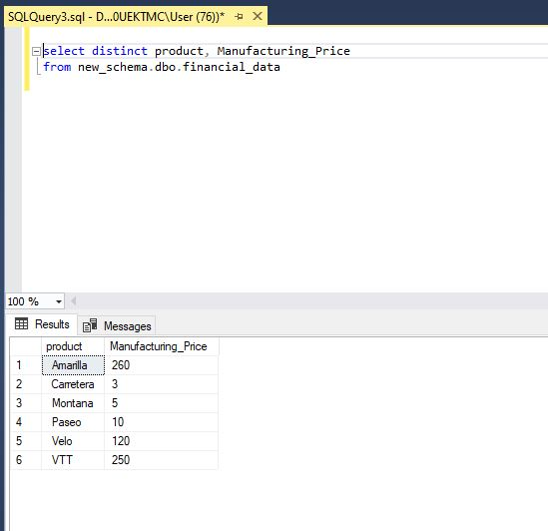
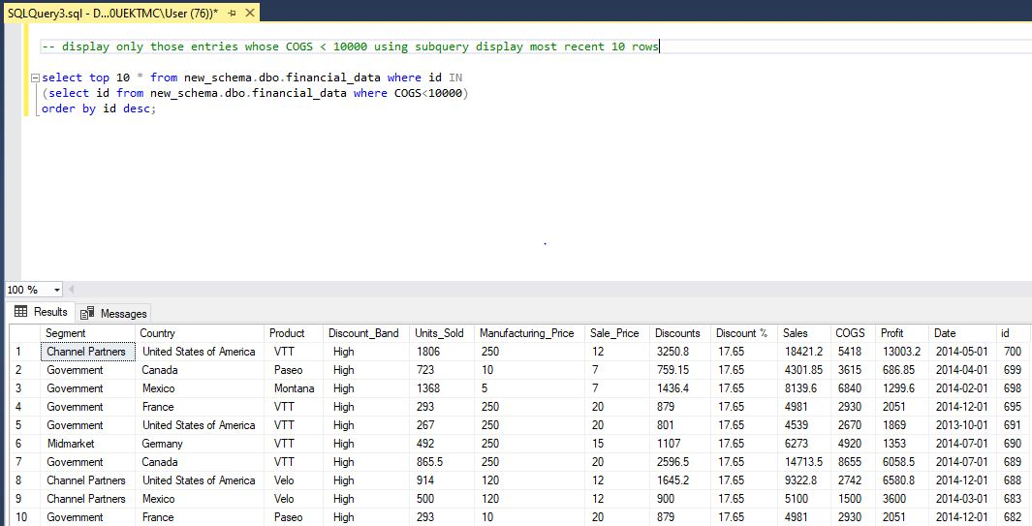
Insert the given data into the SQL server
Please find the attached screenshots

Slide 14
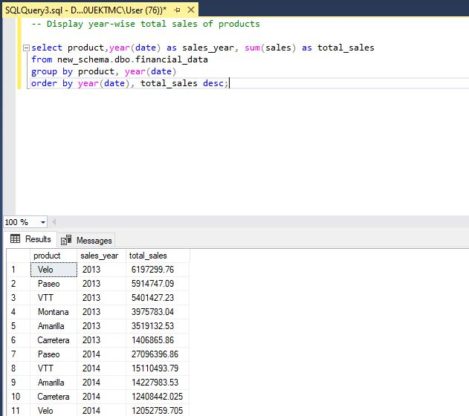
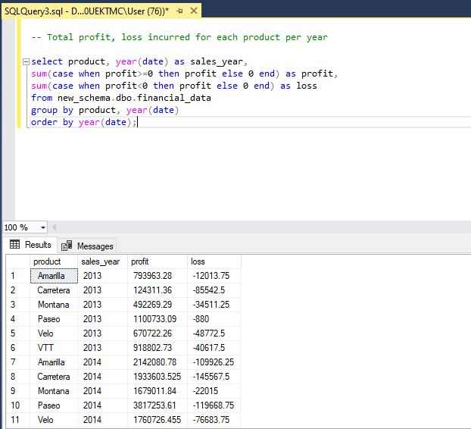
Insert the given data into the SQL server
Please find the attached screenshots

Slide 15
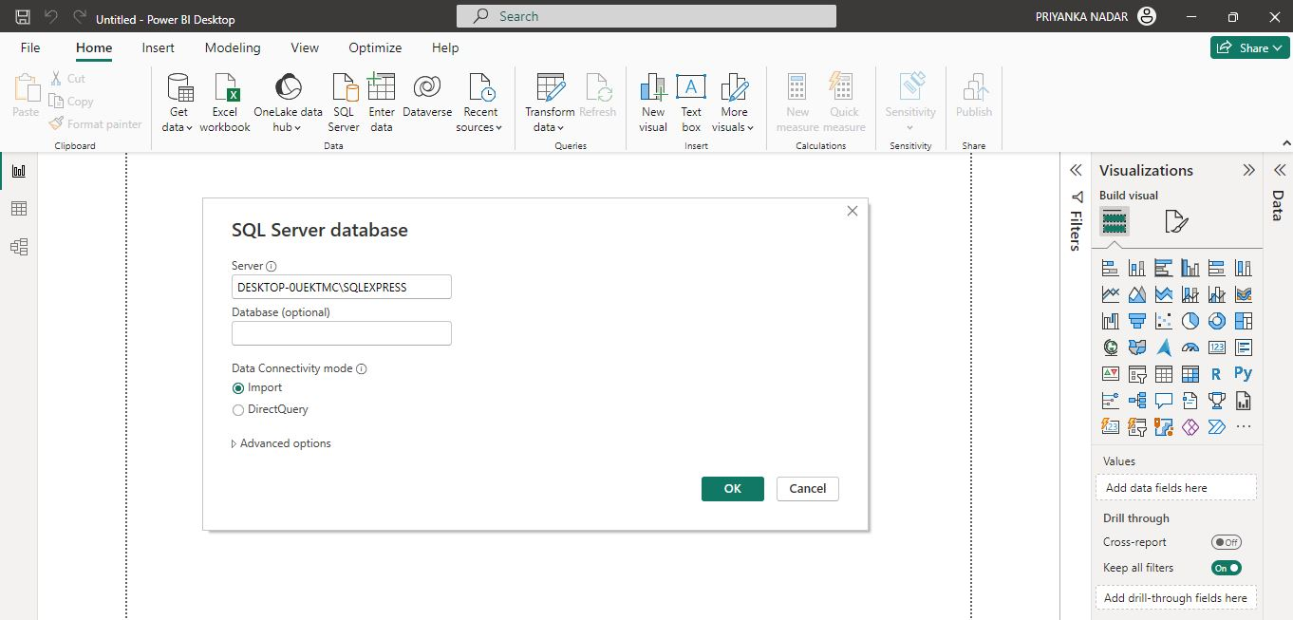
Import the Data from the SQL Database into PowerBI
Data Import from SQL

Slide 16
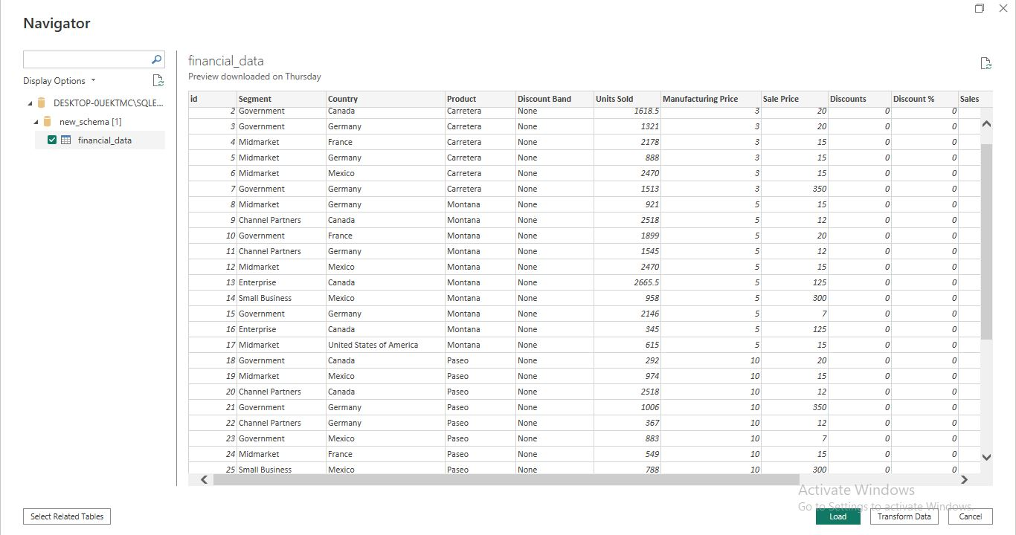
Import the Data from the SQL Database into PowerBI
Data Loading

Slide 17
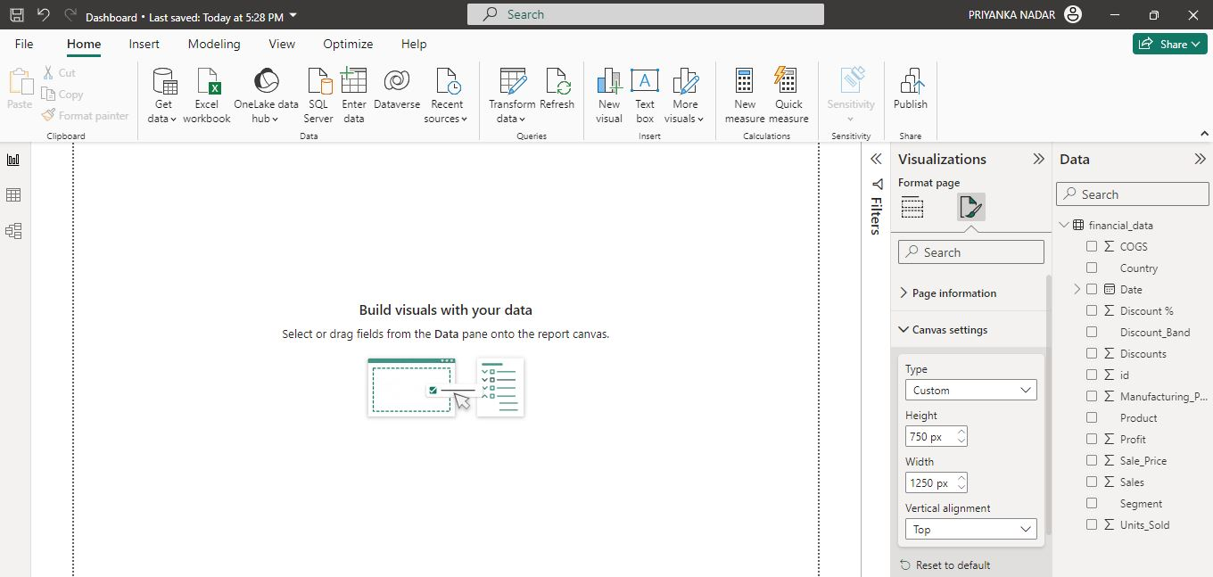
Import the Data from the SQL Database into PowerBI
Data Loaded Successfully
Prepare viz, add filters, and assemble them all in a dashboard (canvas size is 1250 x 750 pixels)

Slide 18
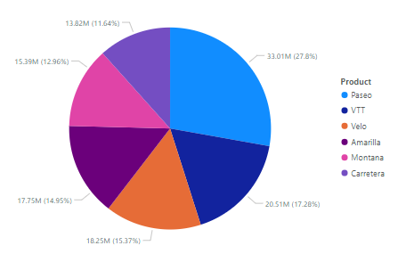
Answer the questions by using visualization tools
Product wise Sales - given in the visualization below
Bottom 3 products(inferring it as products with least sales) - Carretera, Montana and Amarilla

Slide 19
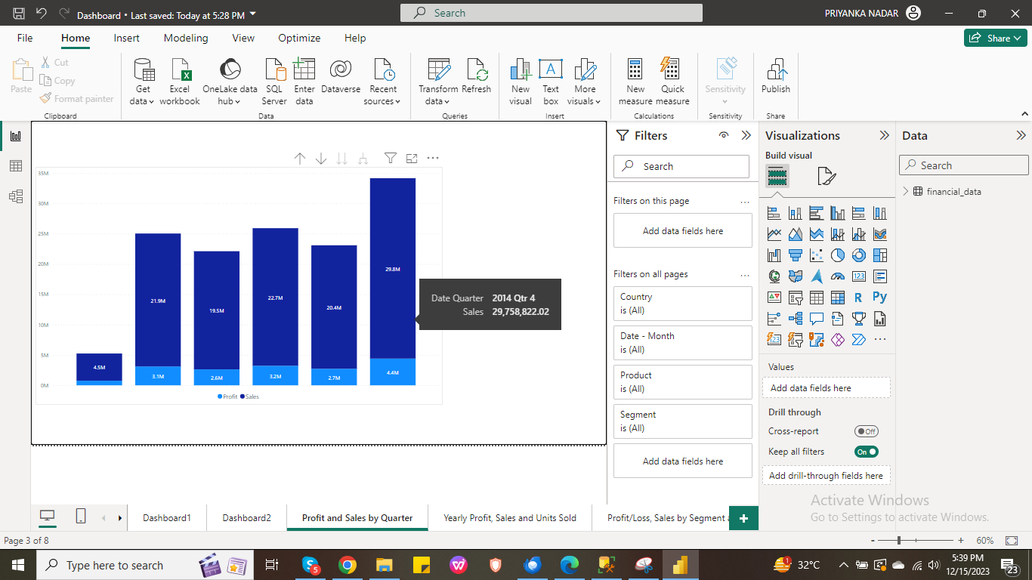
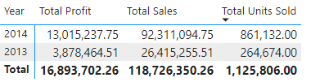
Answer the questions by using visualization tools
Profit and sales by quarter - calculated for all the quarters present according to the dates in dataset
Yearly sales and profit

Slide 20
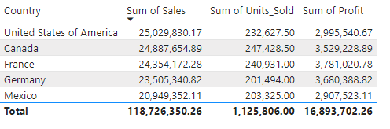
Answer the questions by using visualization tools
Country-wise Sales
Top 2 countries (in terms of sales - USA and Canada, profit – France and Germany, units sold – Canada and France)

Slide 21
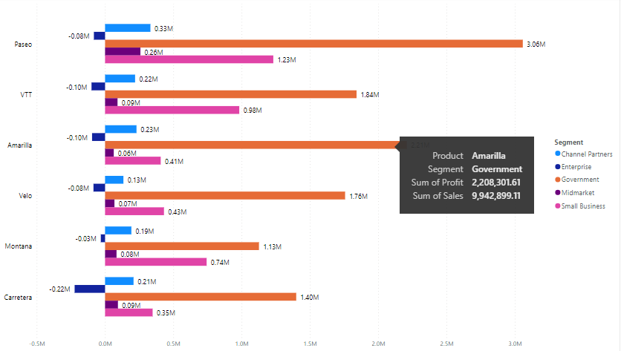
Answer the questions by using visualization tools
Segment-wise and product-wise sales/profit

Slide 22
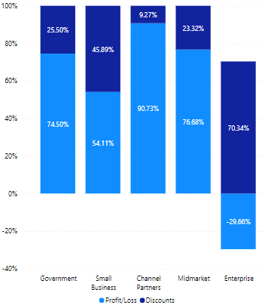
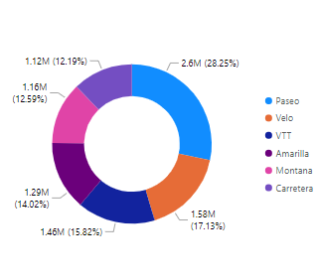
Answer the questions by using visualization tools
Segment-wise profit, discounts
Product-wise discount

Slide 23
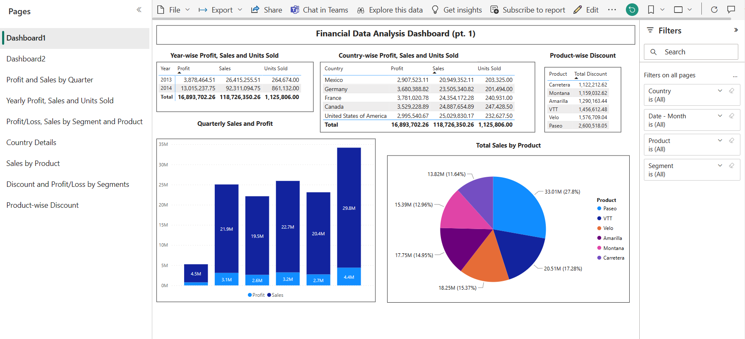
Overall Dashboard

Slide 24
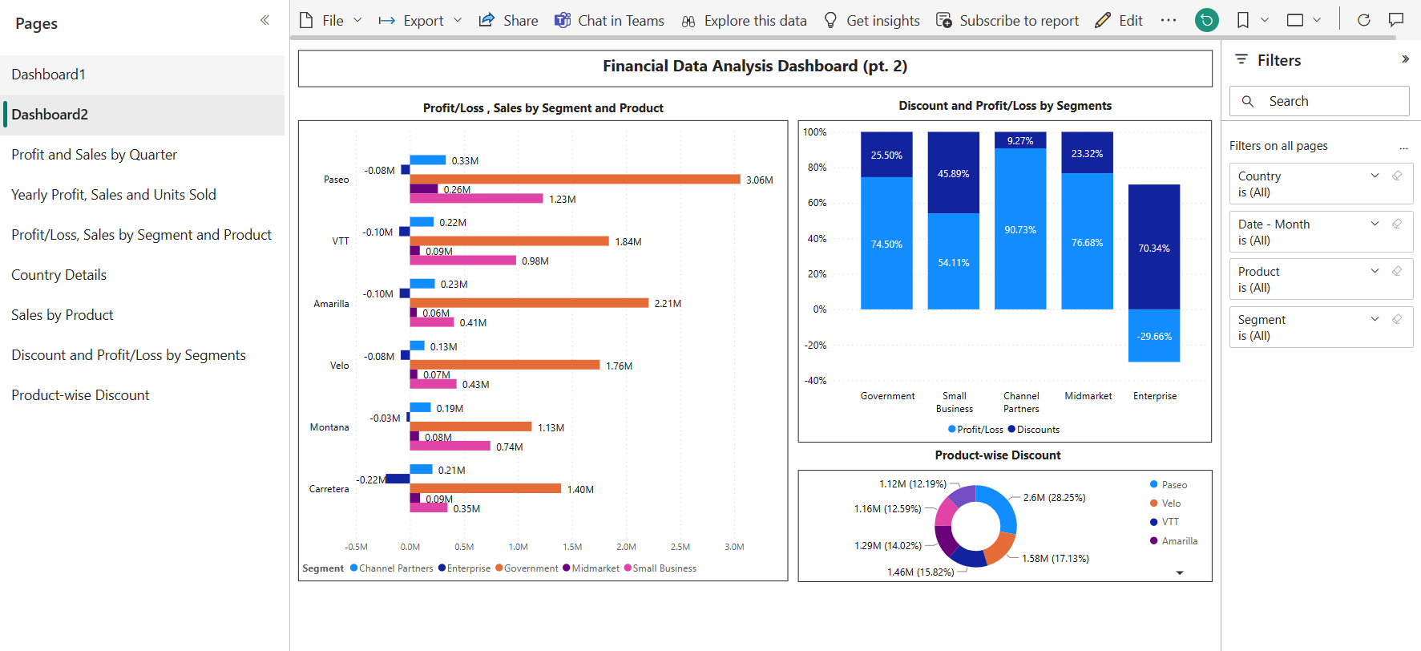
Overall Dashboard

Slide 25
Conclusion and Inferences
Paseo has the highest sales in the ‘Government’ sector
Also, customers trust other products from this segment the most
Germany has sold least number of units but in terms of profit, it has outgrown significantly
With good marketing campaigns, sales can be increased
USA currently looks like it has incurred loss even after higher sales, hence we need to analyze the bigger picture (supply chain, customer satisfaction, etc.) in this region
As the sales are good, it has a scope for improvement
Last quarter of 2014 has been a great time in terms of sales, kudos to the entire team
‘Enterprise’ segment seems to have incurred loss, probably because of the high discount rates offered in products
But at the same time, Paseo, which has the highest number of sales, has offered most discounts to customers
We need to study the customers’ interests in depth and also interact with the sales people to understand their point of view for further analysis

Slide 26
Endnotes
Reference Links:-
Excel, PowerBI and SQL : https://drive.google.com/drive/folders/1J9Gd3y_ub9JogvGBIdQqc9QFVdbnNyfn?usp=sharing

Slide 27
Endnotes
THANK YOU!

